Slide 1
Intelligent Agents
Chapter-2

Slide 2
Outline
Agents and Environments
Rationality
PEAS (Performance measure, Environment, Actuators, Sensors)
Environment Types
Agent Types

Slide 3
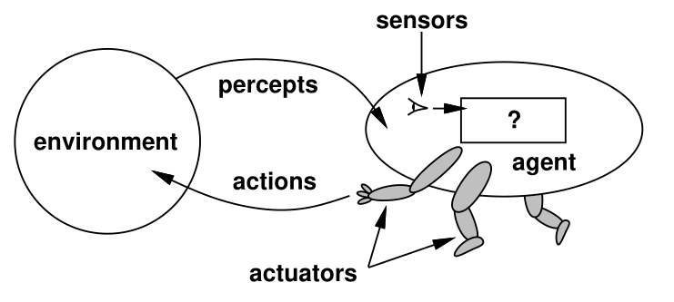
Agents and Environments
An Agent is anything that can be viewed as perceiving its environment through sensors and acting upon that environment through actuators.
Agents include humans, robots, soft-bots, thermostats, etc
Percept = Single input from environment
Percept sequence = Complete sequence of every thing the agent received as input
The agent function maps from percepts histories to actions
F : P* → A
The Agent program runs on the physical architecture to produce F

Slide 4
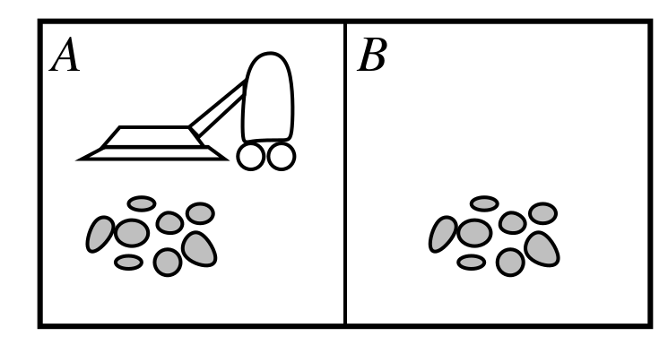
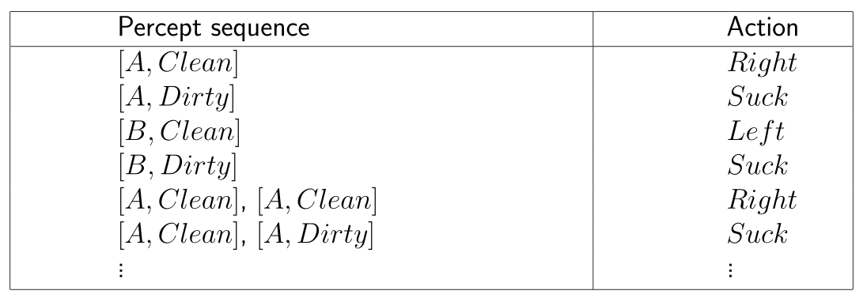
Vacuum Cleaner World
Vacuum Cleaner World: To clean two tiles. If A is clean turn Right, if B is clean turn Left.
Percepts : Location and contents e.g. [A, Dirty], [B, Clean]
Actions: Left, Right, Suck, NoOp

Slide 5
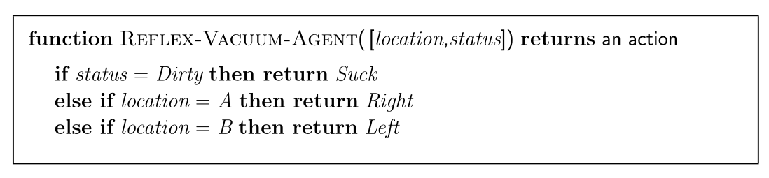
Vacuum Cleaner World
What is the correct function?
Can it be implemented in a small agent program?

Slide 6
Rationality
Fixed performance measure evaluates the environment sequence
– one point per square cleaned up in time T ?
– one point per clean square per time step, minus one per move?
– penalize for > k dirty squares?
A rational agent chooses whichever action maximizes the expected value of the performance measure given the percept sequence to date
Rational != omniscient (Knowing every thing)
– percepts may not supply all relevant information
Rational != clairvoyant (Having super natural ability)
– action outcomes may not be as expected
Hence, rational != successful
Rational ⇒ exploration, learning, autonomy

Slide 7
Rationality
For each possible percept sequence, a rational agent should select an action that is expected to maximize its performance measure, given the evidence provided by the percept sequence and whatever built-in knowledge the agent has.
Exploration
  Information gathering, Exploration can be done
Learning
  Learn as much as possible from what it perceives
Autonomy
  The extent that an agent relies on the prior knowledge of its designer rather than on its own percepts, we say that the agent lacks autonomy.

Slide 8
PEAS
To design a rational agent, we must specify the task environment
Performance:
Environment:
Actuators:
Sensors:
Consider e.g. the task of designing an automated taxi:

Slide 9
PEAS
To design a rational agent, we must specify the task environment
Consider e.g. the task of designing an automated taxi:
Performance: Safety, Destination, Profits, Legality, Comfort, …
Environment: US Streets, Freeways, traffic, pedestrians, weather, …
Actuators: Steering, Accelerator, Brake, Horn, Speaker, Display, …
Sensors: Camera, Accelerometer, Gauges, Engine sensors, Keyboard, GPS, Lidar, Radar, etc

Slide 10
PEAS
Consider e.g. the task of internet shopping agent
Performance: Price, Quality, Appropriateness, Efficiency, …
Environment: Current and future www sites, vendors, shippers, …
Actuators: Display to users, follow URL, Fill forms …
Sensors: HTML page (text, graphics, scripts … )

Slide 11
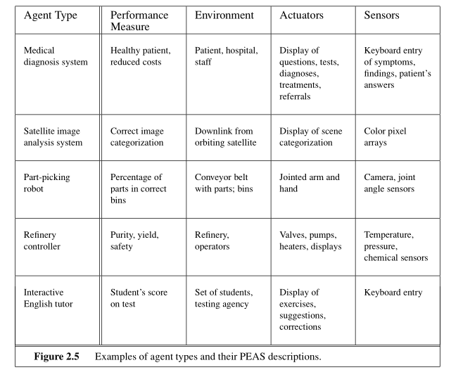
PEAS

Slide 12
Properties of Environments
Observability:
No of Agents:
Competitive:
Determinism:
Episodic, Sequential:
Static vs Dynamic:
Discrete vs Continuous:
Known vs Unknown:

Slide 13
Properties of Environments
Observability: Full observable, Partial observable, unobservable
  Access to complete, partial or no state of the environment
  Agents goals may still be achievable with un-observability
No of Agents: Single agent, Multiple agents
  An agent solving a crossword puzzle by itself is a single agent environment
  An agent playing chess is a two-agent environment.
  Which entities should be treated as an agent?
Competitive Environment:
  Chess is a competitive multi-agent environment
  Taxi driver agent is a partially cooperative multiagent environment.

Slide 14
Properties of Environments
Determinism: Deterministic vs Stochastic
  If next state of environment depends on the current state and the actions of the agent, then we say that the environment is deterministic
  Else it is stochastic.
  In Vacuum cleaner example, randomly appearing dirt, or unreliable suction mechanism can be considered as stochastic elements.
Un Certain:
  Environment is uncertain if it is not fully observable or not deterministic.

Slide 15
Properties of Environments
Episodic vs Sequential:
  Episodic: The agent’s experience is divided into atomic episodes.
  Next episode does not depend on actions taken in previous episode.
  Defect detection in assembly line is episodic.
  Sequential: The current decisions could affect all future decisions.
  Chess and Taxi Driving are sequential i.e. short term actions can have long term consequences.

Slide 16
Properties of Environments
Static vs Dynamic:
  Dynamic : If the environment can change while an agent is deliberating.
  Static: Environment not changing. Easy to handle.
Discrete vs Continuous:
  Applies to states of environment, way time is handled, percepts and actions
  Chess has discrete set of environments, and percepts and actions.
  Taxi-driving has continuous state and time problem
Known vs Unknown
  Agents (or designer’s) knowledge about environment.
  Different from observability.

Slide 17
Properties of Environments
Hardest cases are
  Partially observable
  Multi-agent
  Stochastic
  Sequential
  Dynamic
  Continuous
  Unknown
Taxi Driving has all the features except that its a known problem.

Slide 18
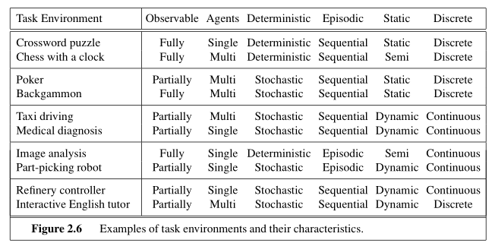
Properties of Environments

Slide 19
Agent Types
Four basic types in order of increasing generality:
  Simple reflex agents
  Reflex agents with state
  Goal based agents
  Utility based agents
All the above can be turned into learning agents

Slide 20
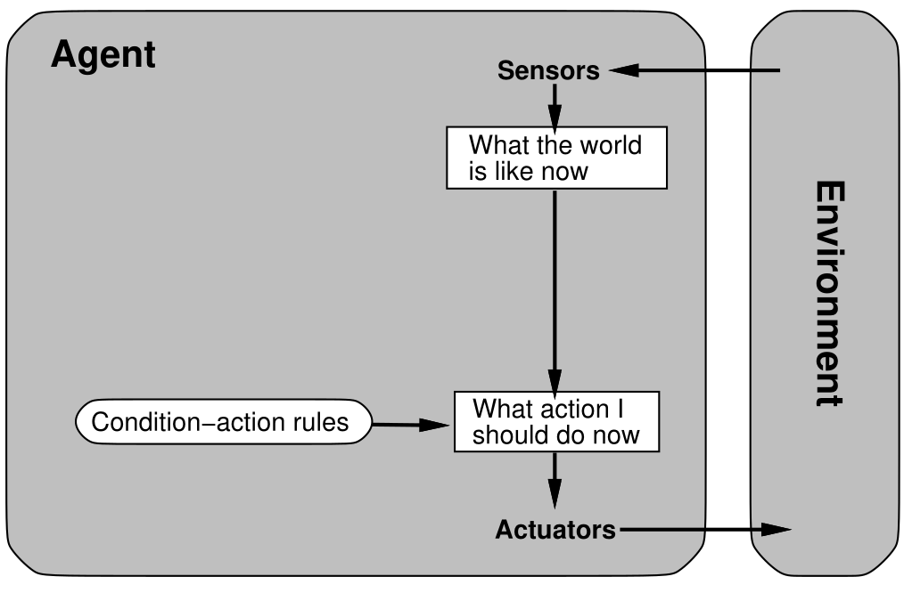
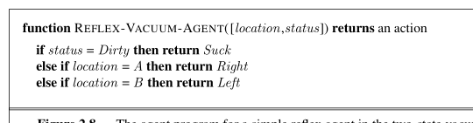
Agent Types – Simple Reflex Agents
Simple Reflex agents
  That selects actions on the basis of the current percept, ignoring rest of the percept history.
Examples
  Vacuum cleaner, as it takes
  decision on the basis of current
  location, and current dirt.

Slide 21
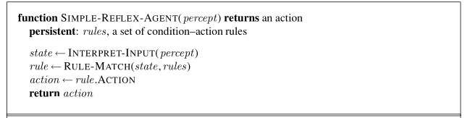
Agent Types – Simple Reflex Agents
Simple Reflex behavior occurs in more complex environment also
  If car in front brakes, its red light appears → then you should notice and initiate your brake
  This is called as condition-action-rule
  If car in front is braking, then initiate braking.
  Humans also have lots of condition-action-rules
How the reflex agents connects percept with rule.

Slide 22
Agent Types – Simple Reflex Agents
Simple Reflex agents have an admirable property of being simple.
But have limited intelligence
  Correct decision to be made if the rule matches i.e. fully observable environment
Example:
  Difficult to determine from a single frame if front car is braking.
  May fall into infinite loop in partially observable environments
Randomized reflex agent mostly outperforms simple deterministic reflex agent.

Slide 23
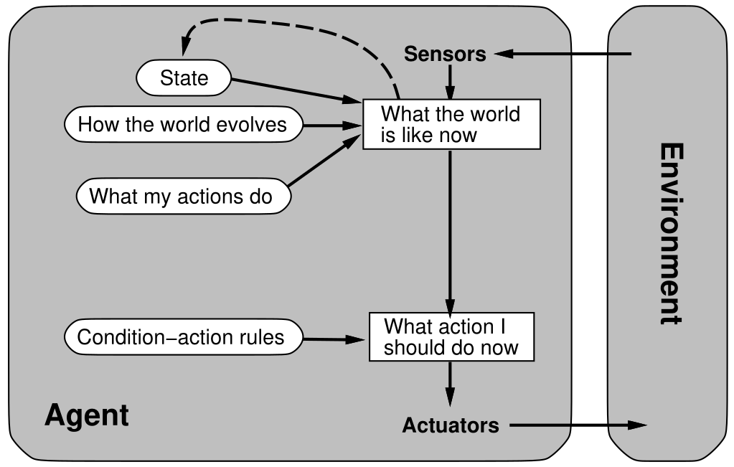
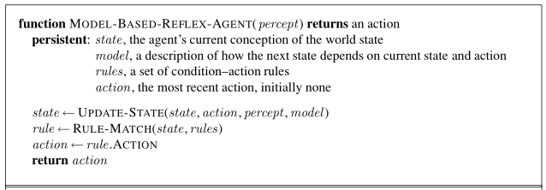
Agent Types – Model/State based Reflex Agents
Agent to keep track of the partial observability through internal state.
Internal state keeps track of the past history
Model is the information about the world.
Update state function varies and depends upon the environment

Slide 24
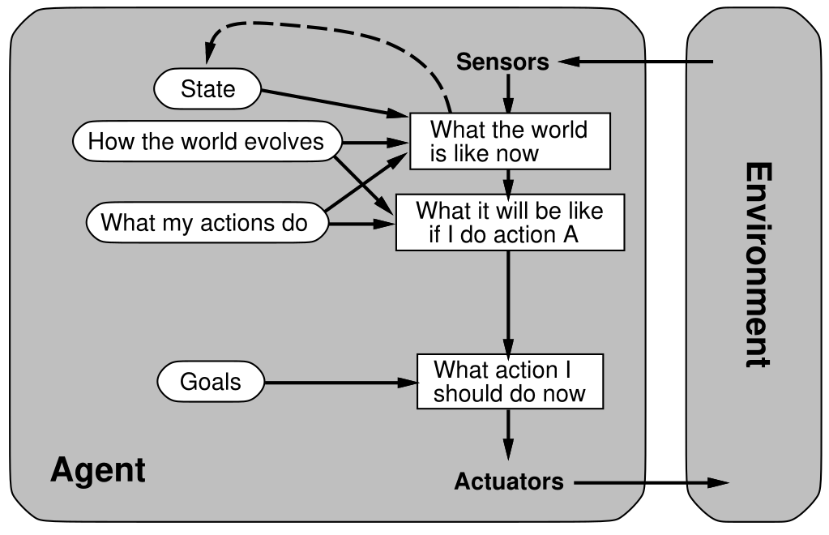
Agent Types – Goal based Agents
The agent needs goal information that describe the desired situation
No condition-action rules.
Search and Planning are the sub-fields of the AI

Slide 25
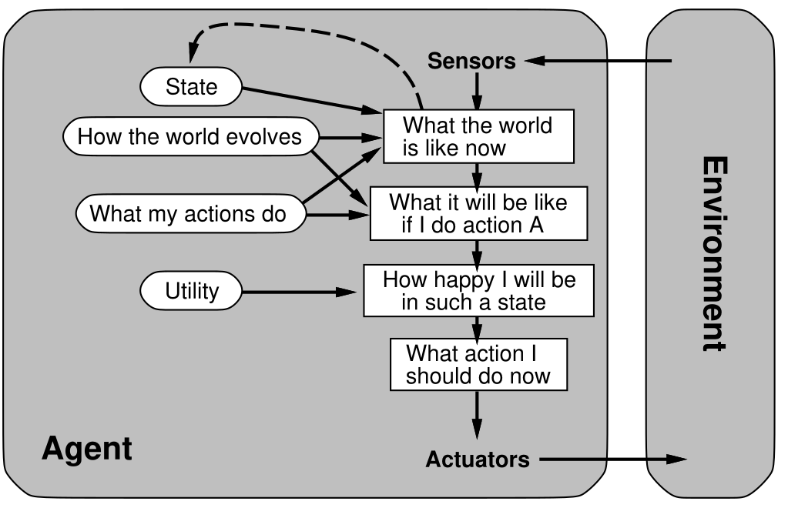

Agent Types – Utility based Agents
Only goal information is not the most rational choice.
We need the best way to reach the goal.
Utility function is an internationalization of performance measure.
Much better performance of utility agents when
  There are conflicting goals i.e. only
  few goals can be achieved.
  There are several goals, and none of them
  can be achieved with certainity.

Slide 26
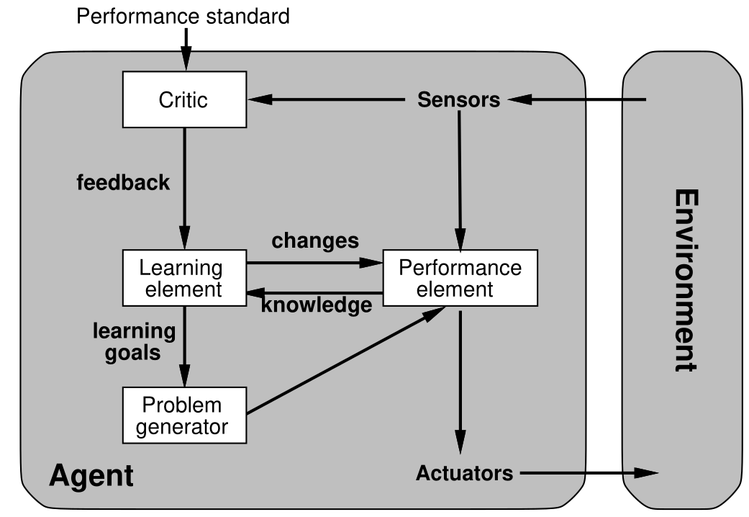
Agent Types – Learning Agents
Learning agents divided into four conceptual components
  Learning Element: Responsible for making improvements.
  Performance Element: Selects external actions.
  Critic: How the model is performing. Feedback loop to performance element
  Problem Generator: Suggests actions
  that will lead to new learning.

Slide 27
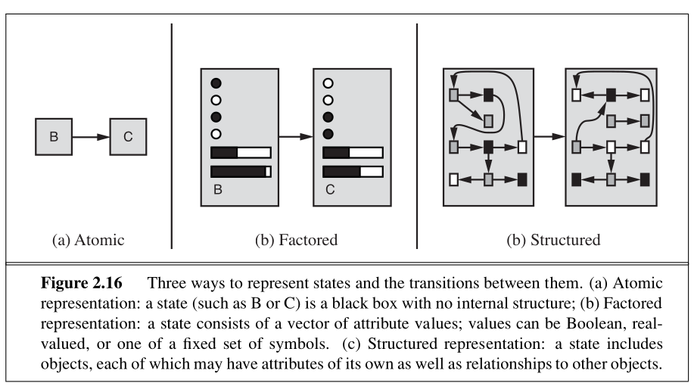
How components of Agent Program work

Slide 28
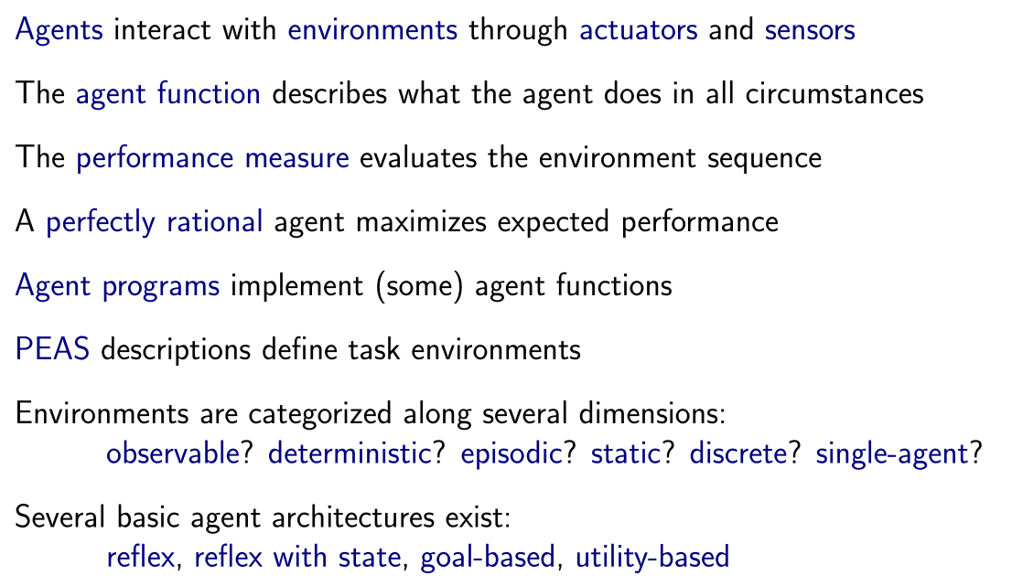
Summary

